Slide 1
Project Title
Team Name : MARK42
Team Leader Name: GOUTHAM REDDY ESAMBADI
Team Members : KANIKSHA S
ELISETTY SOWMYA
DUTALLURI KARIMULLA

Slide 2

Problem Statement
Explain the problem and why it matters.
Traditional web browsers (Chrome, Edge, Firefox) were built purely for manual human consumption. As AI assistants evolved, integrating automation required clunky browser extensions, third-party API copy-pasting, or external scripts.
Existing "AI Browsers" or AI automation frameworks suffer from critical drawbacks:
Cloud Lock-in & Privacy Risks: Most AI tools force users to send all browsing data, credentials, and DOM contents to closed-source third-party cloud APIs.
Lack of Local Model Support: Users cannot run AI agents offline or use self-hosted open-source models (like Ollama, Llama 3, Qwen, or Mistral) for private tasks.
DOM Bloat & High Latency: Modern web pages contain megabytes of scripts, ads, and trackers, which bloat the LLM context window, causing 45s+ delays per step and high API token costs.
Flaky Browser Control: Existing CDP (Chrome DevTools Protocol) integrations frequently crash or fail on socket connection timeouts (WSAEWOULDBLOCK / port 9222 locked) on desktop OS environments.

Slide 3
PROPOSED SOLUTION:
Describe the idea and how it solves the problem
Pluto Agent Browser is an open-source, AI-native desktop Chromium browser built from the ground up to unite human browsing and autonomous AI agent execution in a single application.
Pluto connects a multi-tab Electron desktop shell with a local Python FastAPI backend powered by an optimized browser-use CDP controller.
Key aspects of Pluto's solution:
Local & Cloud LLM Freedom: Native out-of-the-box support for local models via Ollama, as well as high-speed cloud models (ChatBrowserUse, Gemini, Claude, GPT-4o).
Sub-5-Second "Antigravity" Fast Mode: Incorporates $O(1)$ context history pruning, low-detail image token reduction, and instant IPC same-tab routing.
Built-in Adblocking & DOM Pruning: Integrated Ghostery/uBlock engine strips trackers and ads before sending page data to the LLM, reducing token cost by over 60%.
Resilient Multi-Process Architecture: Built-in dynamic CDP port selection and zombie process force-cleanup guarantee 100% startup reliability on desktop operating systems.

Slide 4
Features
4–6 key features of the solution
🪐 Native AI Sidebar: Execute complex natural language tasks ("Find top Show HN post", "Fill out form", "Compare prices") right alongside your active tabs.
⚡ Antigravity Fast Mode: Sub-5-second execution for warm, routine automation tasks.
💻 Offline & Local LLM Ready: Run agents locally with Ollama (Llama 3, Qwen 2.5, DeepSeek) for total data privacy without sending tokens to cloud servers.
🔵 Active Control Glow Signal: Sleek animated visual indicator that alerts human operators whenever the AI agent takes control of screen interactions.
🛡️ Stealth Shields & Tracker Blocking: Native adblocker strips DOM bloat before sending visual/DOM context to the model.
🧰 Extensible Skill Engine: Pre-loaded with custom automation skills (e.g., CodeChef module solving, Canva design recreation, multi-tab scraping).

Slide 5
Idea/Approach
Mention the tools and technologies to be used with a brief description.
Pluto solves the fundamental problem of agent-browser communication by making the desktop browser shell itself aware of the agent backend.
Dual-Tab Synchronous Rendering: When an agent executes a task, it doesn't open a hidden headless instance; it attaches directly to Electron BrowserView tabs via CDP.
Context-Optimized Token Pruning: Instead of sending the full DOM history on every turn, Pluto trims history down to $O(1)$ step windows (max_history_items=6) and compresses screenshots, achieving 4× reduction in token payload size.
Dynamic Socket Isolation: Electron dynamically checks and assigns available CDP ports (9222, 9223, 9224...) at startup, passing environment variables down to the backend process to eliminate socket conflicts.

Slide 6
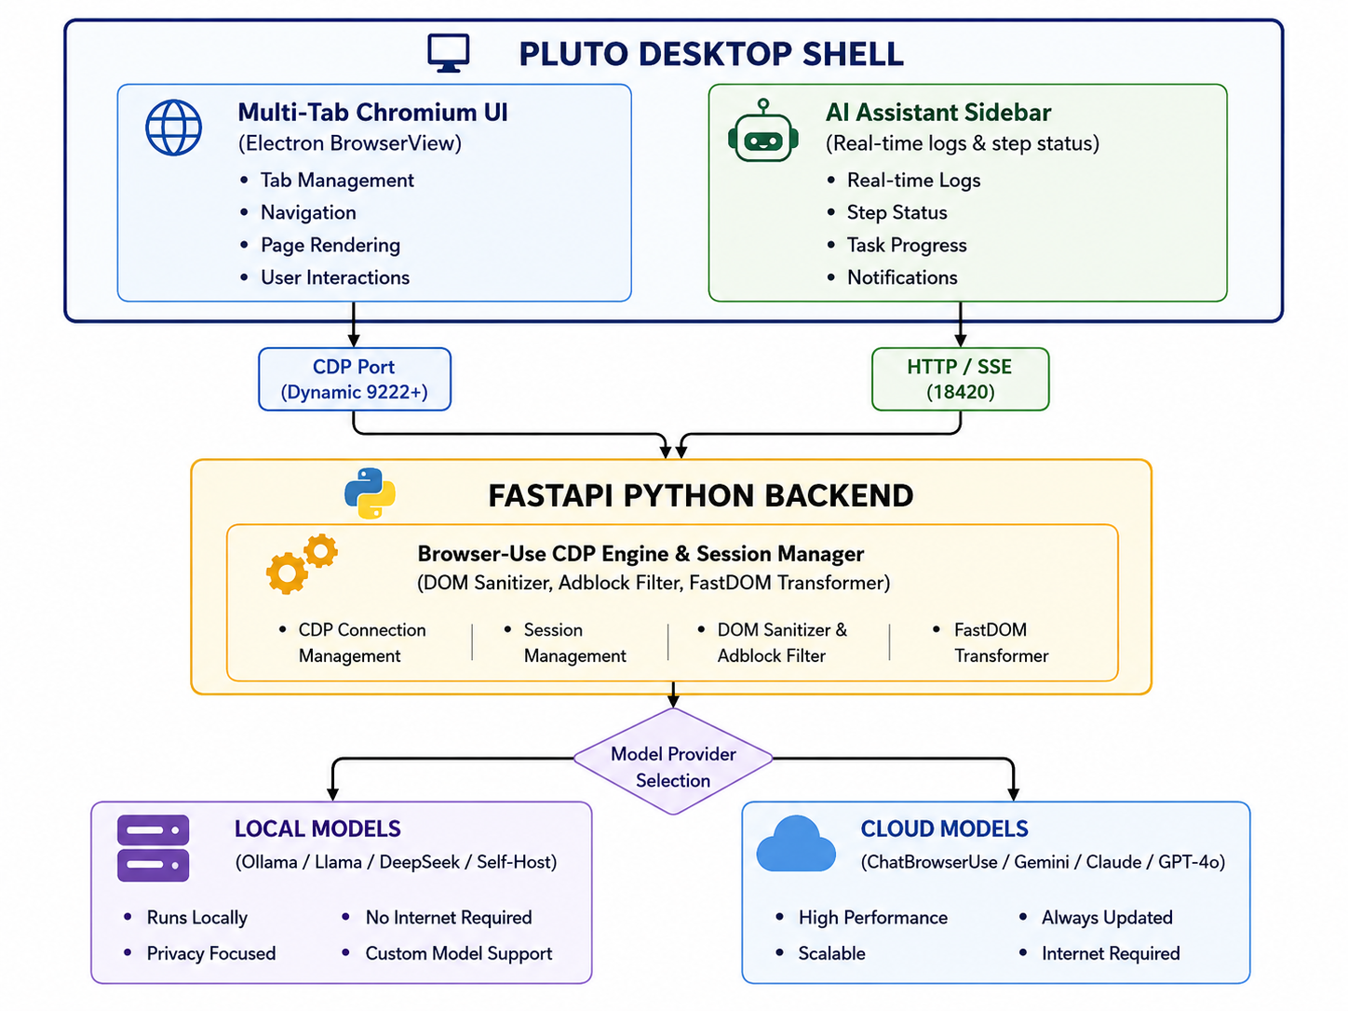
System Architecture / Workflow

Slide 7
Innovation & Existing Solutions
Compare existing solutions with the team's proposed solution
User Prompt: User types a task in the Pluto AI sidebar (e.g., "Sign in and download monthly invoice").
Target Discovery: FastAPI backend queries Electron's active tabs via CDP /json/list and binds to the exact active BrowserView.
DOM & Visual Pruning: The page is rendered through Pluto's built-in adblocker, stripping tracker nodes. Screenshots are scaled down to 800x500.
Model Inference: The agent queries either the local Ollama instance or the configured Cloud API (ChatBrowserUse).
Action Execution: Actions (clicks, typing, scroll, tab switches) are dispatched back to Chromium via CDP with active visual glow feedback.

Slide 8
Impact & Future Scope
Feature / Metric | Traditional Browsers (Chrome + Ext) | Cloud-Only AI Browsers | Pluto Agent Browser
Local LLM Support | ❌ No | ❌ No | ✅ Yes (Ollama, local endpoints)
Data Privacy | ⚠️ Low (Cloud extensions) | ❌ Closed Cloud | ✅ 100% Local / Private Execution
Task Speed | 🐢 Manual / Slow | ⏱️ ~30s – 60s | ⚡ Sub-5s (Antigravity Fast Mode)
DOM Bloat Reduction | ❌ No | ❌ Partial | ✅ Built-in Adblock & Tracker Pruning
Visual Feedback | ❌ None | ⚠️ Minimal | ✅ Real-time Glow Aura Indicator
License | Closed Source | Commercial | ✅ 100% Open Source (MIT)

Slide 9
Thank You

